Slide 1


Phool Kumar Oram
26 July 2026

Slide 2

Outline
Executive Summary
Introduction
Methodology
Results
Conclusion
Appendix

Slide 3
Executive Summary
Summary of methodologies
Summary of all results

Slide 4
Introduction
Project background and context
SpaceX has become one of the frontrunners in the space race
It offers launching a space craft at a price much lower than what is offered by its competitors
One of the main reason why this is possible is because of the reusable nature of its first stage of the rocket
We would like to understand what factors affect the successful landing of the first stage
Problems you want to find answers
Some of the question we would like to answer are: what factor impact the successful landing of the first stage launching site, payload mass, combination of the two, proximity of geographical features like coast to the launching site etc
We also would like to predict the outcome of a launch by modeling its historical data

Slide 5

Section 1

Slide 6
Methodology
Executive Summary
Data collection methodology:
API Request: Pulled data from endpoints SpaceX API using python request library to gather core operational variables.
Web Scraping: Extracted tabular launch records from wikipedia using BeautifulSoup to Supplement missing historical records.
Features Gathered: Collected data points including rocket types, payload mass, launch site coordinates, landing outcome and flight numbers.

Slide 7
Methodology
Perform data wrangling
Missing Value Imputation: Identified null values in critical columns like landing outcomes and replaced them with appropriate categorical placeholders.
Outcome Labeling: Standardized categorical landing string into a clean binary target variable. 1 for successful landing 0 for a failed landing.
One Hot Encoding: Converted categorical features such as Launch Site names and Orbit targets into binary indicator columns for model readiness.

Slide 8
Methodology
Perform exploratory data analysis (EDA) using visualization and SQL
SQL Querying: Used SQLite/DuckDB to write relational queries analyzing flight counts, success rates by site and total payload distribution.
Key Findings: Observed distinct success rate disparities among different launch pads and a general upwards trend in success over time.

Slide 9
Methodology
Perform interactive visual analytics using Folium and Plotly Dash
Folium Maps: Created interactive geographical maps overlaying launch sites with colot coded markers, green for success red for failure to analyze spatial distribution.
Proximity Calculation: Calculated distance from launch compleses to coastline, highways and railways using Folium marker plugins.
Plotly Dash: Developed a live dashboard featuring dropdown filters and range sliders linking landing success rates dynamically to payload mass.

Slide 10
Methodology
Perform predictive analysis using classification models
Model Building: Developed and tuned four core classification algorithms: Logistic regression, Support Vector Machine (SVM), Decision Tree and K-Nearest Neighbors(KNN)
Hyper parameter Tuning: Executed automated grid searches (GridSearchCV) across diverse parameter grids to optimize model metrics.
Model Evaluation: Measured and compared performance across all models using accuracy scores, confusion metrics and jaccard indices to identify the optimal deployment model.

Slide 11
Data Collection
Describe how data sets were collected.
You need to present your data collection process use key phrases and flowcharts

Slide 12
Data Collection – SpaceX API
Present your data collection with SpaceX REST calls using key phrases and flowcharts
Add the GitHub URL of the completed SpaceX API calls notebook (must include completed code cell and outcome cell), as an external reference and peer-review purpose
https://github.com/Phookumar/SpaceX-IBM-Capstone/blob/ee411cf43279b793389d34788ca4689f31de1330/Data%20Collection%20API.ipynb
Use GET request for SpaceX data request get method applied on endpoint in json format
Covert the data into a dataframe using json_normalize()
Fileter the data so that only Falcon9 launches are present-df[df[‘BoosterVersion’]==‘Falcon9]
Replace the row with zero payload mass with that of the mean payload mass – df[‘PayloadMass’].replace()

Slide 13
Data Collection - Scraping
Present your web scraping process using key phrases and flowcharts
Add the GitHub URL of the completed web scraping notebook, as an external reference and peer-review purpose
https://github.com/hprithvi/SpaceX-IBM-Capstone/blob/1fd4a998d51e592561a72d4b013b57b422997961/Web%20Scraping%20SpaceX%20data.ipynb
Create a BeautifulSoup object and pass the response from request.get() command to it.
Extract the column names from the tables by running through the table titles and columns
Extract the data present in the html tables into a dataframe by running through each row in each table
Export the data into a csv file and store it on local memory

Slide 14
Data Wrangling
Describe how data were processed
You need to present your data wrangling process using key phrases and flowcharts
Add the GitHub URL of your completed data wrangling related notebooks, as an external reference and peer-review purpose
https://github.com/hprithvi/SpaceX-IBM-Capstone/blob/fbf55af5fb7b19e6102f65a614cdb75be0b65a/Data%20Wrangling.ipynb
Data was processed by making use of pandas and numpy libraries and associated funstions, methods
Question like launches per site, launches in different orbits,
Create a column in the df called ‘Class’ which is 1 for successful landing and 0 otherwise.
Mean success rate is calculated and the data exported to a csv on local memory

Slide 15
EDA with Data Visualization
Summarize what charts were plotted and why you used those charts
Add the GitHub URL of your completed EDA with data visualization notebook, as an external reference and peer-review purpose
Scatter plots of launcheSite vs Flight Number, Launch Site vs Payload Mass, Orbit vs Flight Number, Orbit vs PayloadMass, Bar chart of success ratevs Orbit, Line plot of average success vs year are plotted.
Feature Engineering was also carried out by creating dummy variables for categorical variables.
https://github.com/hprithvi/SpaceX-IBM-Capstone/blob/745e7048e7078b93d657a7e8071cbbfde78f17c6/EDA%20with%20Viz%20lab.ipynb

Slide 16
EDA with SQL
Using bullet point format, summarize the SQL queries you performed
Select Distinct launch_site to display names of unique launch sites
Number of launches from each launch site
Display top 5 records where launch site begins with ‘CCA’
Display Average and total Payload mass
Launch date of first successful launch
List of booster with successful landing where payload mass is between 4000and 6000kg those that carried maximum payload mass
Add the GitHub URL of your completed EDA with SQL notebook, as an external reference and peer-review purpose
https://github.com/hprithvi/SpaceX-IBM-Capstone/blob/c3ccb70efe9c37dff34c6307dd40fd7f2599226d/EDA%20SQL.ipynb

Slide 17
Build an Interactive Map with Folium
Summarize what map objects such as markers, circles, lines, etc. you created and added to a folium map
Markers, Marker Clusters, Line Circle, pop-up label,
Explain why you added those objects
Markers are used to point to the exact location of the coordinates, Markercluster to depict a bunch of Points associated with one location( here , it’s success and failure of mission) Line to draw a line between two points on the map, Circleto enable pointing out the location on a zoomed out map, pop up label to show some text over a location
Add the GitHub URL of your completed interactive map with Folium map, as an external reference and peer-review purpose
https://github.com/hprithvi/SpaceX-IBM-Capstone/blob//Data%20Collection%20API.ipynb

Slide 18
Build a Dashboard with Plotly Dash
Summarize what plots/graphs and interactions you have added to a dashboard
Explain why you added those plots and interactions
Add the GitHub URL of your completed Plotly Dash lab, as an external reference and peer-review purpose

Slide 19
Predictive Analysis (Classification)
Summarize how you built, evaluated, improved, and found the best performing classification model
Used sklearnlibrary to split and train the data. Built GridSearchCVobjects for different techniques like Logistic Regression, Decision Trees, Support Vector Machine, and K-Nearest Neighboursand found the best performing parameters on train data and tested the scores for test data
You need present your model development process using key phrases and flowchart
Add the GitHub URL of your completed predictive analysis lab, as an external reference and peer-review purpose
https://github.com/hprithvi/SpaceX-IBM-Capstone/blob/7bcada08e001d71e2efb6d930cf53354f374c449/ML%20Prediction.ipynb
Split Data into train and test | Grid SearchCV Object | Find Best Performing parameter | Check the Model on Test Data

Slide 20
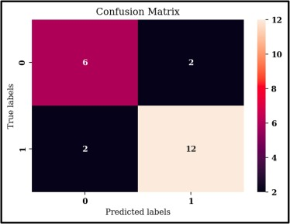
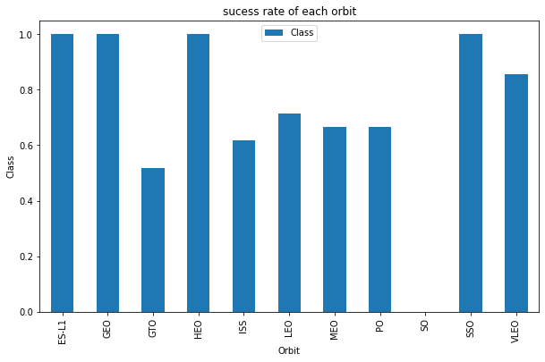
Results
Exploratory data analysis results
Interactive analytics demo in screenshots
Predictive analysis results

Slide 21

Section 2

Slide 22
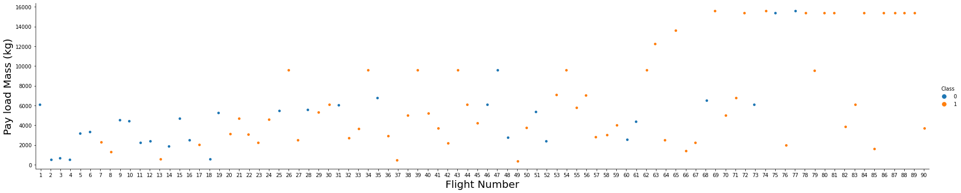
Flight Number vs. Launch Site
Show a scatter plot of Flight Number vs. Launch Site
Show the screenshot of the scatter plot with explanations
This plot shows a scatter plot of site of launch for a given flight number with success/failure indicated in the legend
We can observe that failure are fewer in the later part of the X-axis which means that the success rate has improved over time.

Slide 23
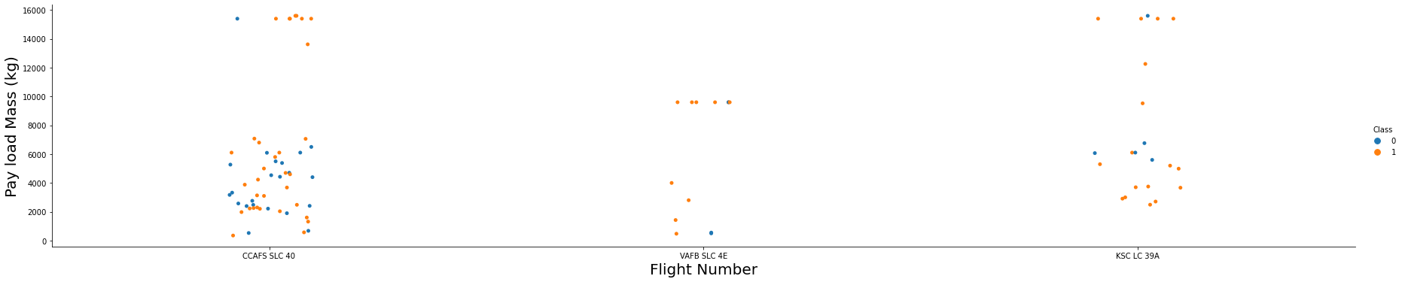
Payload vs. Launch Site
Show a scatter plot of Payload vs. Launch Site
Show the screenshot of the scatter plot with explanations
The above is a scatter plot of Launch site vs. Payload Mass with success/failure indicated in the legend.
It can be observed that for higher payload mass, success rates are relatively higher

Slide 24
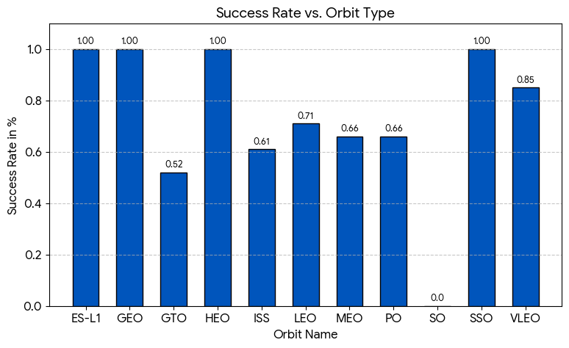
Success Rate vs. Orbit Type
Show a bar chart for the success rate of each orbit type
Show the screenshot of the scatter plot with explanations
Success rate apparently depends on the orbit type also. A few orbits have 100% success arte. These orbit could be desirable for someone trying to launch a spacecraft.

Slide 25
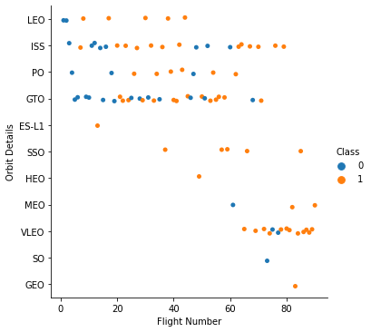
Flight Number vs. Orbit Type
Show a scatter point of Flight number vs. Orbit type
Show the screenshot of the scatter plot with explanations
The above scatter plot clearly shows that certain orbit have high success rate. But it seems that a few orbit are preferred. We can also see a shift in the preference of orbit over time with VLEO orbit being preferred of late.

Slide 26
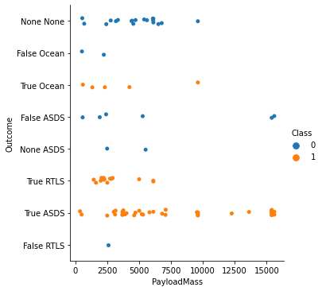
Payload vs. Orbit Type
Show a scatter point of payload vs. orbit type
Show the screenshot of the scatter plot with explanations
Majority of the launches seems to have the payload in the rage of 2000-6000kg
Success rate seems to be higher payload mass (>8000kg), however, number of such launches seems to be less

Slide 27
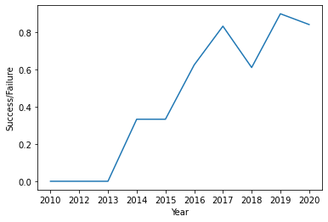
Launch Success Yearly Trend
Show a line chart of yearly average success rate
Show the screenshot of the scatter plot with explanations
Success rate with time has increased with the highest success rate getting register in 2019
Only in 2018, 2020 the success rate is lower than that of the previous year.

Slide 28
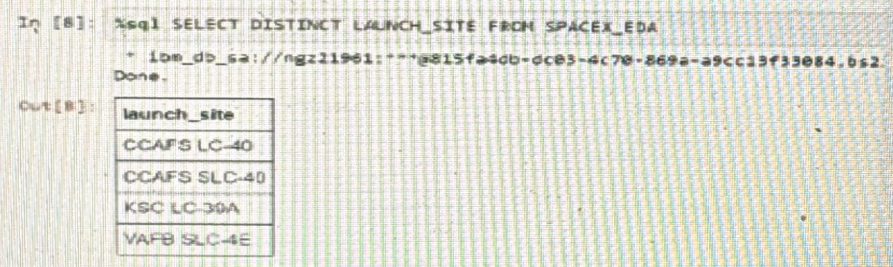
All Launch Site Names
Find the names of the unique launch sites
Present your query result with a short explanation here
There are four unique launch sites. DISTINCT is used to get the unique values from the table

Slide 29
Launch Site Names Begin with 'CCA'
Find 5 records where launch sites begin with `CCA`
Present your query result with a short explanation here
 | Date | Time (UTC) | Booster_Version | Launch_Site | Payload | PAYLOAD_MASS__KG_ | Orbit | Customer | Mission_Outcome | Landing_Outcome
0 | 2010-06-04 | 18:45:00 | F9 v1.0 B0003 | CCAFS LC-40 | Dragon Spacecraft Qualification Unit | 0 | LEO | SpaceX | Success | Failure (parachute)
1 | 2010-12-08 | 15:43:00 | F9 v1.0 B0004 | CCAFS LC-40 | Dragon demo flight C1, two CubeSats, barrel of... | 0 | LEO (ISS) | NASA (COTS) NRO | Success | Failure (parachute)
2 | 2012-05-22 | 7:44:00 | F9 v1.0 B0005 | CCAFS LC-40 | Dragon demo flight C2 | 525 | LEO (ISS) | NASA (COTS) | Success | No attempt
3 | 2012-10-08 | 0:35:00 | F9 v1.0 B0006 | CCAFS LC-40 | SpaceX CRS-1 | 500 | LEO (ISS) | NASA (CRS) | Success | No attempt
4 | 2013-03-01 | 15:10:00 | F9 v1.0 B0007 | CCAFS LC-40 | SpaceX CRS-2 | 677 | LEO (ISS) | NASA (CRS) | Success | No attempt

Slide 30
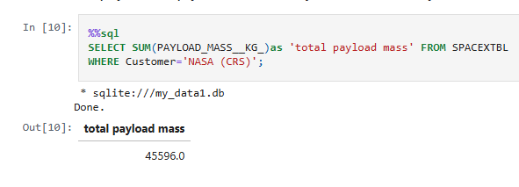
Total Payload Mass
Calculate the total payload carried by boosters from NASA
Present your query result with a short explanation here

Slide 31
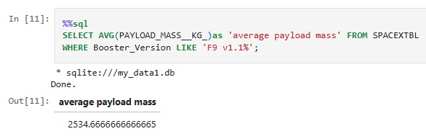
Average Payload Mass by F9 v1.1
Calculate the average payload mass carried by booster version F9 v1.1
Present your query result with a short explanation here
WHERE and AVG() are used to get average payload mass in Falcon 9 v1.1 booster version.

Slide 32
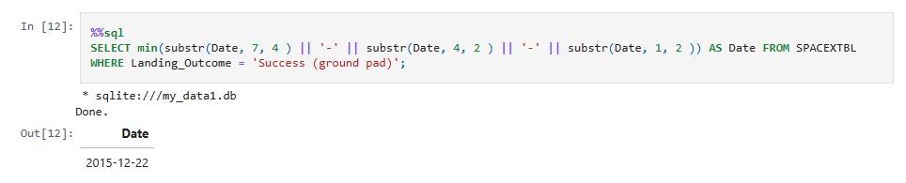
First Successful Ground Landing Date
Find the dates of the first successful landing outcome on ground pad
Present your query result with a short explanation here
MIN() function is applied on Date column in conjunction with WHERE function

Slide 33
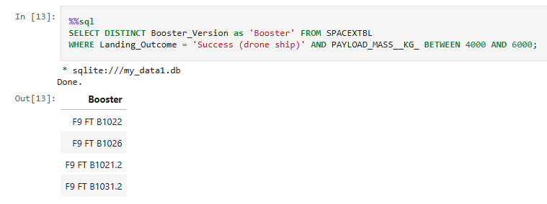
Successful Drone Ship Landing with Payload between 4000 and 6000
List the names of boosters which have successfully landed on drone ship and had payload mass greater than 4000 but less than 6000
Present your query result with a short explanation here
BETWEEN function is applied on Payload Mass column to get the booster versions that operated with payload mass between 4000 and 6000

Slide 34
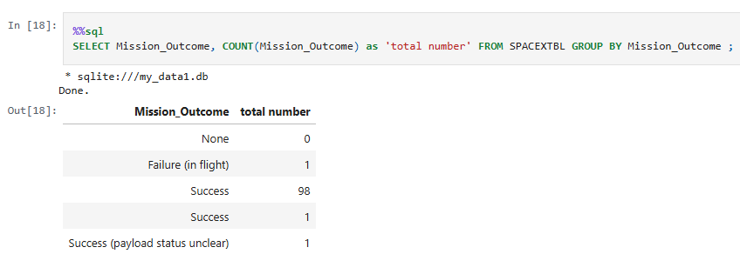
Total Number of Successful and Failure Mission Outcomes
Calculate the total number of successful and failure mission outcomes
Present your query result with a short explanation here
A total of 100 successful mission and 1 failed mission is presented by using SUM() function on Mission_Outcome column

Slide 35
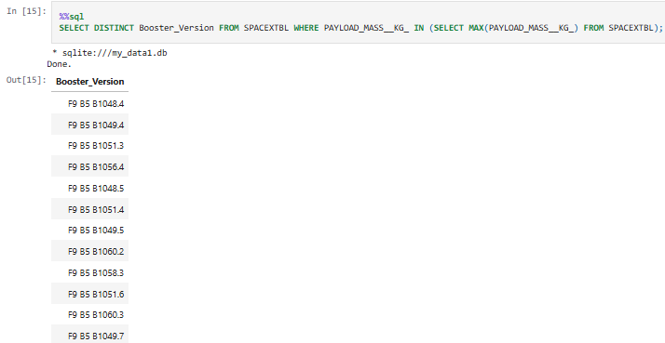
Boosters Carried Maximum Payload
List the names of the booster which have carried the maximum payload mass
Present your query result with a short explanation here
A sub query is used to get the max payload and used as an input in the main query to get the list of booster which carried the maximum load.

Slide 36
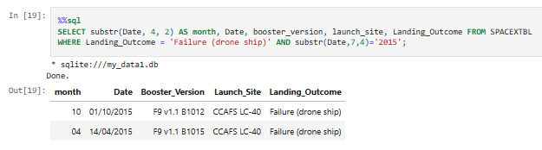
2015 Launch Records
List the failed landing_outcomes in drone ship, their booster versions, and launch site names for in year 2015
Present your query result with a short explanation here
WHERE is used in conjunction with AND to get failed landing outcomes in 2015

Slide 37
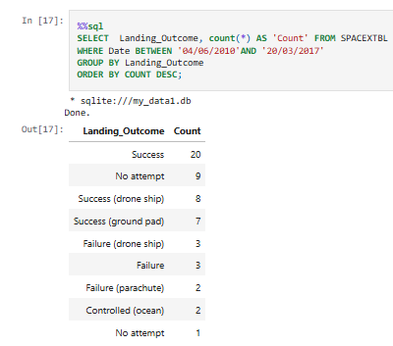
Rank Landing Outcomes Between 2010-06-04 and 2017-03-20
Rank the count of landing outcomes (such as Failure (drone ship) or Success (ground pad)) between the date 2010-06-04 and 2017-03-20, in descending order
Present your query result with a short explanation here
WHERE DATE is between is used to
get records in that date range,
GROUP BY is used to get set of
landing outcomes DESC is used to
get the results in descending order

Slide 38

Section 3

Slide 39
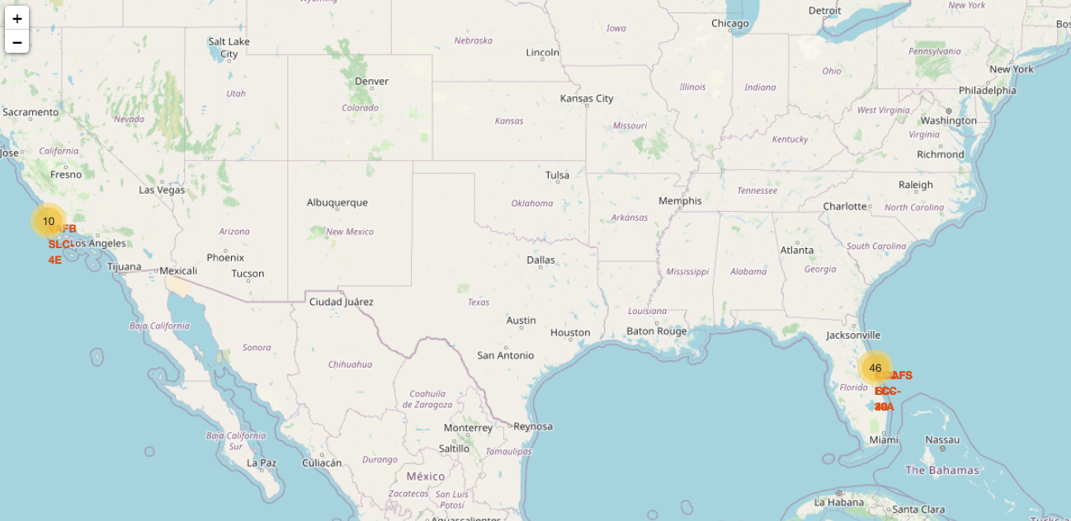
<Folium Map Screenshot 1>
Replace <Folium map screenshot 1> title with an appropriate title
Explore the generated folium map and make a proper screenshot to include all launch sites’ location markers on a global map
Explain the important elements and findings on the screenshot
Launch centres on the Map Only markers are visible in this zoomed out picture with names superimposed on the markers.

Slide 40
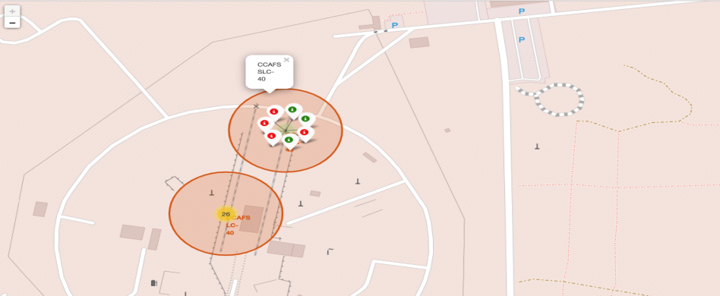
<Folium Map Screenshot 2>
Replace <Folium map screenshot 2> title with an appropriate title
Explore the folium map and make a proper screenshot to show the color-labeled launch outcomes on the map
Explain the important elements and findings on the screenshot
From the color-labeled markers in marker
clusters, you should be able to easily
identify which launch sites have
relatively high success rates.

Slide 41

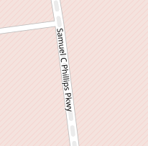
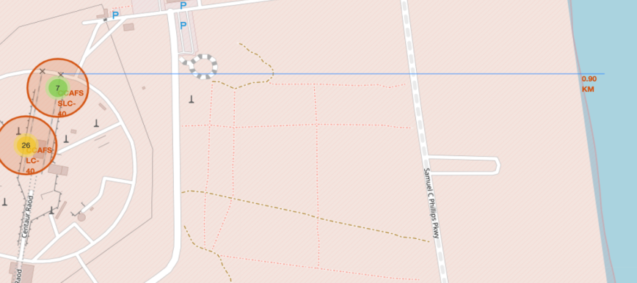
<Folium Map Screenshot 3>
Replace <Folium map screenshot 3> title with an appropriate title
Explore the generated folium map and show the screenshot of a selected launch site to its proximities such as railway, highway, coastline, with distance calculated and displayed
Explain the important elements and findings on the screenshot
Line showing proximity to railway line and cost.
It can be observed that the launch site are close to railway line and also coast.

Slide 42

Section 4

Slide 43
<Dashboard Screenshot 1>
Replace <Dashboard screenshot 1> title with an appropriate title
Show the screenshot of launch success count for all sites, in a piechart
Explain the important elements and findings on the screenshot

Slide 44
<Dashboard Screenshot 2>
Replace <Dashboard screenshot 2> title with an appropriate title
Show the screenshot of the piechart for the launch site with highest launch success ratio
Explain the important elements and findings on the screenshot

Slide 45
<Dashboard Screenshot 3>
Replace <Dashboard screenshot 3> title with an appropriate title
Show screenshots of Payload vs. Launch Outcome scatter plot for all sites, with different payload selected in the range slider
Explain the important elements and findings on the screenshot, such as which payload range or booster version have the largest success rate, etc.

Slide 46

Section 5

Slide 47
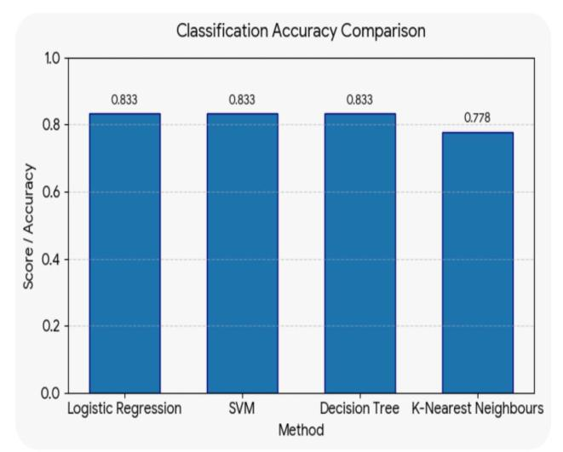
Classification Accuracy
Visualize the built model accuracy for all built classification models, in a bar chart
Find which model has the highest classification accuracy
Logistic Regression, SVM, Decision Tree models
have same accuracy of 83.3% while KNN model
has a lower accuracy of 77.8%
Model | Accuracy/ Score
Logistic Regression | 0.833
SVM | 0.833
Decision Tree | 0.833
K-Nearest Neighbors | 0.778

Slide 48
Confusion Matrix
Show the confusion matrix of the best performing model with an explanation
15 out of 18 outcomes have been correctly predicted by the mode

Slide 49
Conclusions
Landing outcome depends on flight parameters like payload mass, launch site, the orbit into which it is launched
Launch sites are closer to place like coast, railway line etc.
The success rate has increased over time
Out of the 4 different models that were used to model the data, 3 Models give the same accuracy in predicting the outcome. KNN performs poorly compared to the other models

Slide 50
Appendix
Include any relevant assets like Python code snippets, SQL queries, charts, Notebook outputs, or data sets that you may have created during this project

Slide 51


